Slide 1
SWE30003 Software Architecture and Design
Lecture 5 Object Design (Part I) –
Responsibility-Driven Design

Slide 2
Logistical matters
Weekly submissions – A & Q
Week 2: 104 & 101 out of 119;
Week 3: 101 & 98 out of 118;
Week 4: 102 & 101 out of 118;
Week 5: 98 & 98 out of 118;
Week 6:
Note that this is a hurdle requirement
No late submission
4 people have not submitted anything so far; another 6 do not have 40%.
Assignment 1: … not long to due date

Slide 3
Question to Answer - Week 4
A good programmer in these times does not just write programs, he/she builds a working vocabulary. Provide examples and explain this statement.
----
Notes:
Working vocabulary” - two aspects:
Cross programs
Within program
----
Abstractions, pattern, meta, extension

Slide 4
Principal References
Rebecca Wirfs-Brock, Brian Wilkerson and Lauren Wiener, Designing Object-Oriented Software, Prentice Hall, 1990, Chapters 3 to 5.
Bernd Bruegge and Allen H. Dutoit, Object-oriented Software Engineering, Prentice Hall, 2001, Chapter 5.
Shari L. Pfleeger, Software Engineering: Theory and Practice (2nd Edition), Prentice Hall, 2001, Chapters 5 and 6.
Ian Sommerville, Software Engineering (9th Edition), Addison Wesley, 2013, Chapter 7.

Slide 5
Object-Oriented Design
OOD != OOP
Notes:
NOT everything is an object. EG, in OOP “button” in an UI can be modelled as an object, but NOT in OOD at the domain/business level.

Slide 6
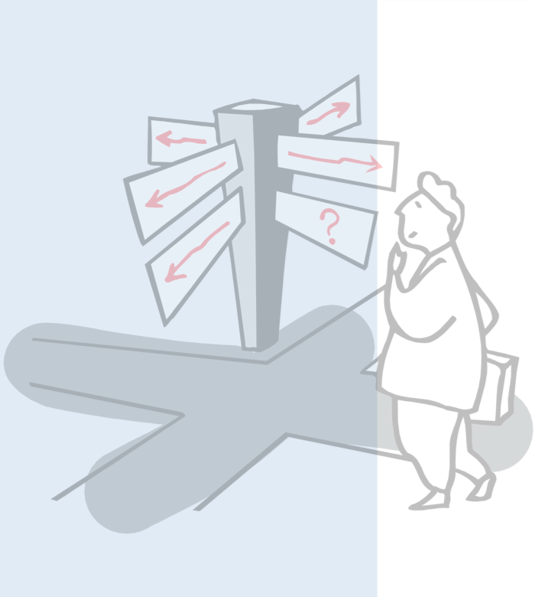
Roadmap
Preliminaries
Objects and Classes
What is Object-Oriented Design?
Finding Classes
Class Selection Rationale
CRC Cards
Identifying Responsibilities
Finding Collaborations
Notes:
Familiar concepts, BUT deeper reflection, and analysis → deeper understanding and better use --- considered/rationalised use! … at a higher level of abstraction.

Slide 7
Decomposition
Decomposition is a process that helps to manage the complexity of the system
Starting with a high-level view of the system.
Creating the low-level details of the features of the system in turn.
Stop when we are satisfied with the level of detail.
Also known as Divide-and-Conquer.

Slide 8
Decomposition (cont.)
Top level
“Architecture”
Adapted from Figure 5.3, Pfleeger 2001
First level
Second level
Notes:
At the top level, there is the architecture or system design. This is the fundamental framework for structuring the system, not hierarchy!). In it are described the principal subsystems and their relationships, where a subsystem is an independent software unit. This is (not) going to be a part of the focus of (later part of) this course, but you need to be aware that large systems will require this level of design. There are lots of different models of architectures.
At successive lower levels, the subsystems are decomposed into modules. In OO analysis and design, we get a set of loosely coupled objects with well-defined interfaces. Alternatively, decompositions could be functional eg using DFDs.

Slide 9
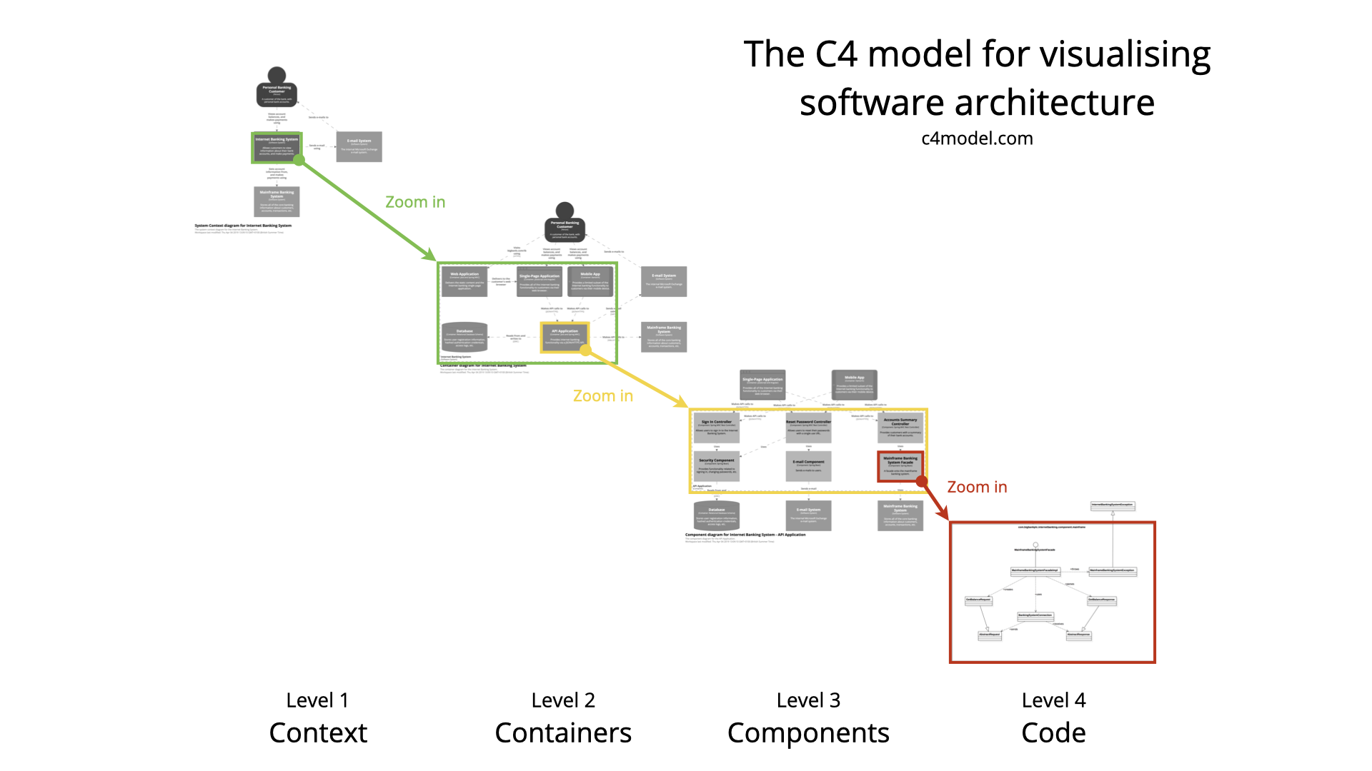

Slide 10
Coupling and Cohesion
Two measures of how well the parts of a system are tied together to form the system itself.
They also give good indication of how “good” the design is
Coupling:
measure the inter-dependency between system parts
Cohesion:
measure the intra-dependency of a system part
Goal: Weak Coupling and Strong Cohesion
Good Object-oriented design attempts to achieve this!
Notes:
Pfleeger 2nd ed. p. 220–226
Bruegge p.174 covers these concepts in the context of subsystems in section 6.3.3. He uses the term ‘coherence’ as ‘cohesion’. The concepts here are more general than is discussed in textbook.

Slide 11
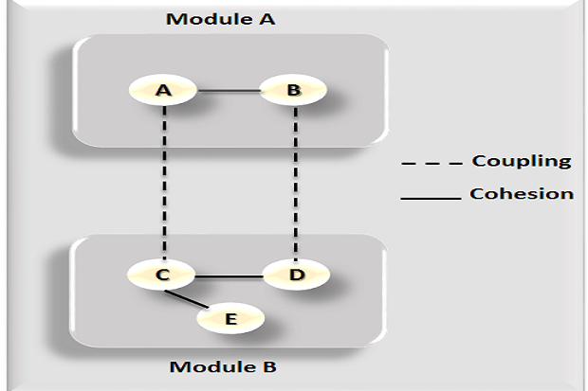

Slide 12
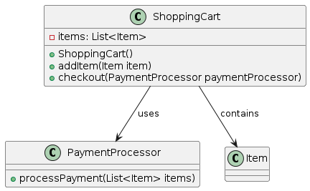
Tight coupling
Why tight coupling? • Classes depend directly on concrete implementations • A change in one class forces changes in all dependent classes • Hard to test in isolation — dependencies cannot be swapped • Reuse is difficult; classes cannot work without each other

Slide 13
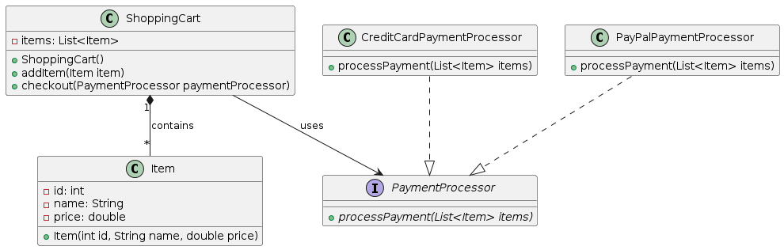
Low coupling
Why low coupling? Classes communicate through interfaces/abstractions, not concrete types • Changing one class has no ripple effect on others • Each class can be tested and reused independently • New implementations can be swapped in without touching dependent code

Slide 14
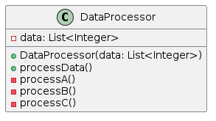
Low Cohesion
// Example of low cohesion in a class
public class DataProcessor {
private List<Integer> data;
public DataProcessor(List<Integer> data) {
this.data = data;
}
public void processData() {
// Example of low cohesion: processData method performing unrelated tasks
processA();
processB();
processC();
}
private void processA() {
// Processing logic for task A
}
private void processB() {
// Processing logic for task B
}
private void processC() {
// Processing logic for task C
}
}
Why low cohesion? • DataProcessor handles unrelated tasks A, B & C in one class • A class should have one clear responsibility • Mixing concerns makes the class harder to understand, maintain, and reuse • Changes to task A risk breaking tasks B and C

Slide 15
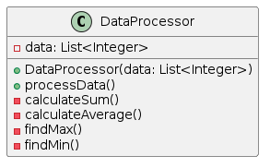
Strong Cohesion
// Example of strong cohesion in a class
public class DataProcessor {
private List<Integer> data;
public DataProcessor(List<Integer> data) {
this.data = data;
}
public void processData() {
// Example of strong cohesion: processData method focused on a single purpose
calculateSum();
calculateAverage();
findMax();
findMin();
}
private void calculateSum() {
// Logic to calculate the sum of elements in data
}
private void calculateAverage() {
// Logic to calculate the average of elements in data
}
private void findMax() {
// Logic to find the maximum element in data
}
private void findMin() {
// Logic to find the minimum element in data
}
}
Why strong cohesion? • Each class has one clear responsibility — DataProcessor only orchestrates, not implements • processA, processB, processC are separate classes with focused logic • Easy to understand, test, and modify each class in isolation • Adding a new process requires no changes to existing classes

Slide 16
Roadmap
Preliminaries
Objects and Classes
What is Object-Oriented Design?
Finding Classes
Class Selection Rationale
CRC Cards
Identifying Responsibilities
Finding Collaborations

Slide 17
What is an Object?
Analysis and modeling view:
an abstract model of a real world entity that has an independent identity.
E.g., Computer, Person, Car
Design and implementation view
a software component that contains a collection of data and related procedures.
An object
represents something in real world that has an independent identity.
is something that you can interact with:
receive and response to messages.
has behaviour which may depend on its internal state which may change by responding to messages.
Object vs Class
Notes:
Although the terms “class” and “object” are distinguished, we still have object-oriented design instead of class-oriented design.
From Analysis to Design, we need a way to capture an object from real world entity and “transform” the entity to a software component.
This should be revision from SD1
Identity
State
Behaviour
Messages
First three covered in detail on the next three slides

Slide 18
What is an Object?
knows information
performs computations
Processing
Object
Interaction
Composition
maintains connections (to other objects)
can be composed
(as part of other objects)
Notes:
… and then get away with the notion of an Object in the middle – let’s call it a “Processing Element”…
… and one can already highlight the notion of “Separation of Concerns”

Slide 19
In fact…
contains information
performs computations
Processing Element
maintains connections (to other processing elements)
can be composed
(as part of other PEs)
Notes:
We will discuss the notion of a “generic” process elements in later lectures…
But -> in most instances, you can safely replace the term ‘object’ with ‘processing element’ and it should still be OK… only inheritance is not directly supported… but this can be an issue anyway…

Slide 20
What is a Class?
A class is a description of a group of objects with
common data attributes
common operations
common relationships to objects; and
common semantics (i.e. “meaning”)
Classes are used to create objects:
Such objects are called instances of their creating class
Object-Oriented Design often focuses on identifying classes, not objects! … but,
Analysis & dynamic behaviour in terms of objects
Notes:
Note that the last dot point can become an issue… over focus on static entities, rather than dynamic entities… one weekly reading deals with this ‘dilemma’…

Slide 21
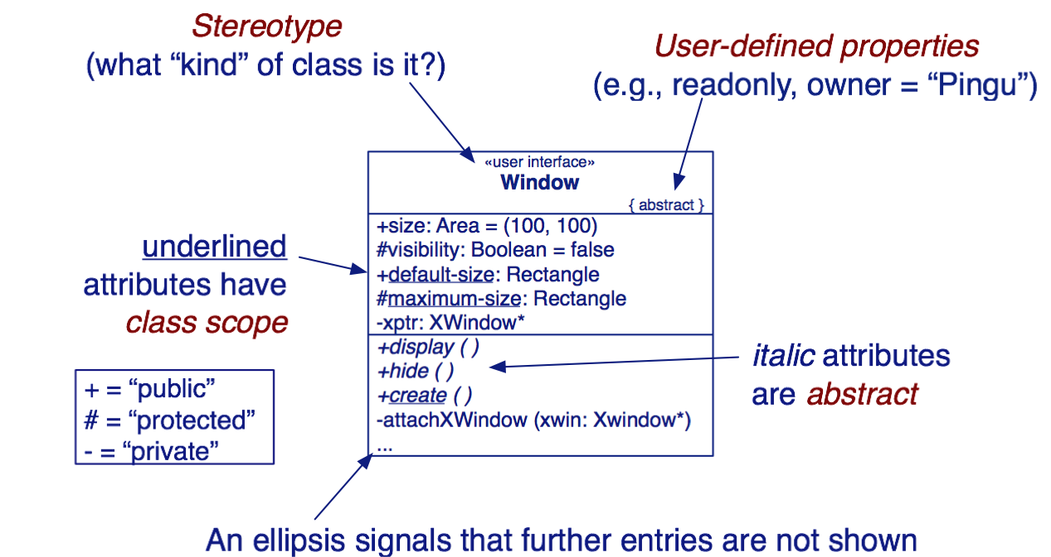
Classes in UML
Don’t worry about visibility too early!
*** In high-level design, less concerned about details (methods, attributes, etc)!!!

Slide 22
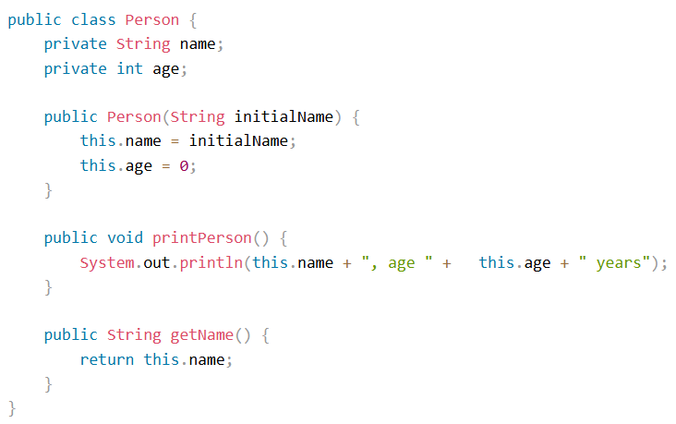
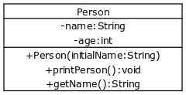

Slide 23
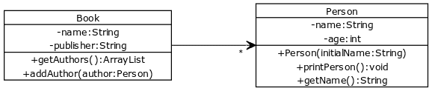
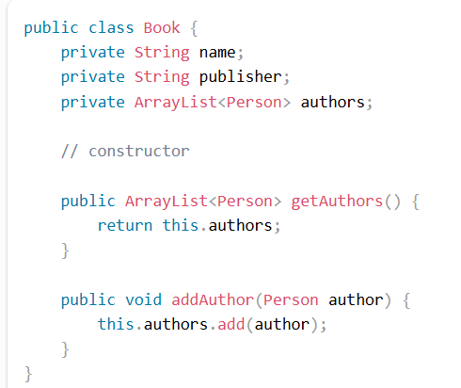

Slide 24
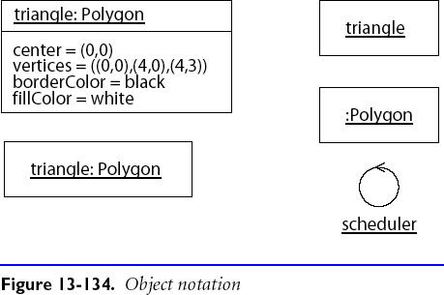
Objects in UML
Objects are shown as rectangles with their name and type underlined in one compartment, and attribute values, optionally, in a second compartment.
At least one of the name or the type must be present.
*** In high-level design, less concerned about details (methods, attributes, etc)!!!

Slide 25
Roadmap
Preliminaries
Objects and Classes
What is Object-Oriented Design?
Finding Classes
Class Selection Rationale
CRC Cards
Identifying Responsibilities
Finding Collaborations

Slide 26
Object-oriented Design
A method of design encompassing the process of object-oriented decomposition.
A notation for depicting the (detailed) characteristics of the system under design
View the system as the interactions of different objects.
Problem: many OO design approaches focus too much on the static relationships…

Slide 27
Object-oriented Design (cont.)
Goal:
To find the important object-based abstractions of the system
What happens if we find the wrong abstraction?
Iterate and correct the model
Questions (of importance)
How can we identify objects (or classes)?
How do objects interact?
What roles and responsibilities do objects perform?
… before writing down in UML/program!

Slide 28
Roadmap
Preliminaries
Objects and Classes
What is Object-Oriented Design?
Finding Classes
Class Selection Rationale
CRC Cards
Identifying Responsibilities
Finding Collaborations

Slide 29
Why Object-Oriented Design?
Decompose according to the functions a system is supposed to perform.
Functional Decomposition:
Good in a “waterfall” approach: stable requirements and one monolithic function
However
Naive: modern systems perform more than one function
Maintainability: system functions evolve ⇒ redesign affect whole system
Interoperability: interfacing with other system is difficult

Slide 30
Why Object-Oriented Design (cont.)?
Decompose according to the objects a system is supposed to manipulate.
Object-Oriented Decomposition:
Better for complex and evolving systems
However
How to find the objects?

Slide 31
Iteration in Object-Oriented Design
The result of the design process is not a final product:
design decisions may be revisited, even after implementation
design is rarely linear but iterative
The design process is not algorithmic:
a design method provides guidelines, not fixed rules
a good sense of style often helps produce clean, elegant designs — designs that make a lot of sense from the engineering standpoint
Responsibility-driven design is an (analysis and) design technique that works well in combination with various methods and notations.

Slide 32
Case Study: Drawing Editor
The drawing editor is an interactive graphics editor. With it, users can create and edit drawings composed of lines, rectangles, ellipses and text.
Tools control the mode of operation of the editor. Exactly one tool is active at any given time.
Two kinds of tools exist: the selection tool and creation tools. When the selection tool is active, existing drawing elements can be selected with the cursor. One or more drawing elements can be selected and manipulated; if several drawing elements are selected, they can be manipulated as if they were a single element. Elements that have been selected in this way are referred to as the current selection. The current selection is indicated visually by displaying the control points for the element. Clicking on and dragging a control point modifies the element with which the control point is associated.
When a creation tool is active, the current selection is empty. The cursor changes in different ways according to the specific creation tool, and the user can create an element of the selected kind. After the element is created, the selection tool is made active and the newly created element becomes the current selection.
The text creation tool changes the shape of the cursor to that of an I-beam. The position of the first character of text is determined by where the user clicks the mouse
button. The creation tool is no longer active when the user clicks the mouse button outside the text element. The control points for a text element are the four corners of the region within which the text is formatted. Dragging the control points changes this region. The other creation tools allow the creation of lines, rectangles and ellipses. They change the shape of the cursor to that of a crosshair. The appropriate element starts to be created when the mouse button is pressed, and is completed when the mouse button is released. These two events create the start point and the stop point.
The line creation tool creates a line from the start point to the stop point. These are the control points of a line. Dragging a control point changes the end point.
The rectangle creation tool creates a rectangle such that these points are diagonally opposite corners. These points and the other corners are the control points. Dragging a control point changes the associated corner.
The ellipse creation tool creates an ellipse fitting within the rectangle defined by the two points described above. The major radius is one half the width of the rectangle, and the minor radius is one half the height of the rectangle. The control points are at the corners of the bounding rectangle. Dragging control points changes the associated corner.

Slide 33
The Initial Exploration
Find the classes in your system.
Determine the responsibilities of each class.
Determine how objects collaborate with each other to fulfill their responsibilities.
These will be discussed in this lecture.

Slide 34
The Detailed Analysis
Factor common responsibilities to build class hierarchies
Streamline collaborations between objects:
Is message traffic heavy in parts of the system?
Are there classes that collaborate with everybody?
Are there classes that collaborate with nobody?
Are there groups of classes that can be seen as subsystems?
Apply design heuristics to improve specific design aspects
These will be discussed in the next lecture.

Slide 35
Finding Classes
Start with the requirements:
What are the goals of the system being designed, its expected inputs, and desired responses?
Look for noun phrases:
separate into obvious classes, uncertain candidates, and nonsense.
Note: we did something similar to create a domain model! – extend/refine and revise here.
Notes:
Hence if a suitable domain model is available, the “only” thing we may have to do is to extend/revise it!

Slide 36
Finding Classes (cont.)
Refine to a list of candidate classes. Some guidelines are:
Model physical objects — e.g. disks, printers
Model conceptual entities — e.g. windows, files
Choose one word for one concept — what does it mean within the system
Be wary of adjectives — is it really a separate class?
Be wary of missing or misleading subjects — rephrase in active voice
Model categories of classes — delay modeling of inheritance
Model interfaces to the system — e.g., user interface, program interfaces
Model attribute values, not attributes — e.g., Point vs. Centre

Slide 37
Drawing Editor: Noun Phrases
The drawing editor is an interactive graphics editor. With it, users can create and edit drawings composed of lines, rectangles, ellipses and text.
Tools control the mode of operation of the editor. Exactly one tool is active at any given time.
Two kinds of tools exist: the selection tool and creation tools. When the selection tool is active, existing drawing elements can be selected with the cursor. One or more drawing elements can be selected and manipulated; if several drawing elements are selected, they can be manipulated as if they were a single element. Elements that have been selected in this way are referred to as the current selection. The current selection is indicated visually by displaying the control points for the element. Clicking on and dragging a control point modifies the element with which the control point is associated.
When a creation tool is active, the current selection is empty. The cursor changes in different ways according to the specific creation tool, and the user can create an element of the selected kind. After the element is created, the selection tool is made active and the newly created element becomes the current selection.

Slide 38
The text creation tool changes the shape of the cursor to that of an I-beam. The position of the first character of text is determined by where the user clicks the mouse button. The creation tool is no longer active when the user clicks the mouse button outside the text element. The control points for a text element are the four corners of the region within which the text is formatted. Dragging the control points changes this region. The other creation tools allow the creation of lines, rectangles and ellipses. They change the shape of the cursor to that of a crosshair. The appropriate element starts to be created when the mouse button is pressed, and is completed when the mouse button is released. These two events create the start point and the stop point.
The line creation tool creates a line from the start point to the stop point. These are the control points of a line. Dragging a control point changes the end point.
The rectangle creation tool creates a rectangle such that these points are diagonally opposite corners. These points and the other corners are the control points. Dragging a control point changes the associated corner.
The ellipse creation tool creates an ellipse fitting within the rectangle defined by the two points described above. The major radius is one half the width of the rectangle, and the minor radius is one half the height of the rectangle. The control points are at the corners of the bounding rectangle. Dragging control points changes the associated corner.

Slide 39
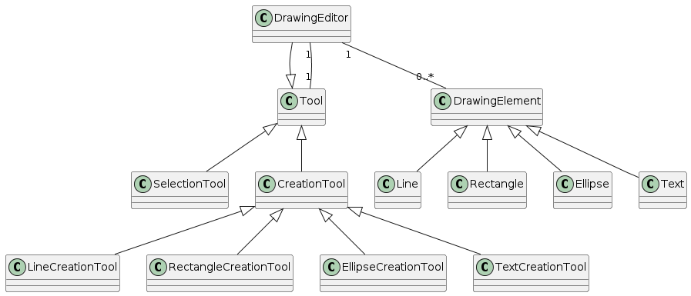

Slide 40
Roadmap
Preliminaries
Objects and Classes
What is Object-Oriented Design?
Finding Classes
Class Selection Rationale
CRC Cards
Identifying Responsibilities
Finding Collaborations

Slide 41
Class Selection Rationale
Model physical objects:
mouse button [event or attribute]
Model conceptual entities:
ellipse, line, rectangle
Drawing, Drawing Element
Tool, Creation Tool, Ellipse Creation Tool, Line Creation Tool, Rectangle Creation Tool, Selection Tool, Text Creation Tool
Text, Character
Current Selection

Slide 42
Class Selection Rationale (II)
Choose one word for one concept:
Drawing Editor ⇒ editor, interactive graphics editor
Drawing Element ⇒ element
Text Element ⇒ text
Ellipse Element, Line Element, Rectangle Element ⇒ ellipse, line, rectangle

Slide 43
Class Selection Rationale (III)
Be wary of adjectives:
Ellipse Creation Tool, Line Creation Tool, Rectangle Creation Tool, Selection Tool, Text Creation Tool
all have different requirements
bounding rectangle, rectangle, region ⇒ Rectangle
common meaning, but different from Rectangle Element!
Point ⇒ end point, start point, stop point
Control Point
more than just a coordinate
corner ⇒ associated corner, diagonally opposite corner
no new behaviour

Slide 44
Class Selection Rationale (IV)
Be wary of sentences with missing or misleading subjects:
“The current selection is indicated visually by displaying the control points for the element.”
by what? Assume Drawing Editor ...
Model categories:
Tool, Creation Tool
Model interfaces to the system: — no good candidates here ...
user — don’t need to model user explicitly
cursor — cursor motion handled by operating system

Slide 45
Class Selection Rationale (V)
Model values of attributes, not attributes themselves:
height of the rectangle, width of the rectangle
major radius, minor radius
position — of first text character; probably Point attribute
mode of operation — attribute of Drawing Editor
shape of the cursor, I-beam, crosshair — attributes of Cursor
corner — attribute of Rectangle
time — an implicit attribute of the system

Slide 46
Candidate Classes
Preliminary analysis yields the following candidates:
Character | Line Element
Control Point | Point
Creation Tool | Rectangle
Current Selection | Rectangle Creation Tool
Drawing | Rectangle Element
Drawing Editor | Selection Tool
Drawing Element | Text Creation Tool
Ellipse Creation Tool | Text Element
Ellipse Element | Tool
Line Creation Tool
Expect the list to evolve as design progresses.
Notes:
There are a total of 19 candidate classes (so far…)

Slide 47
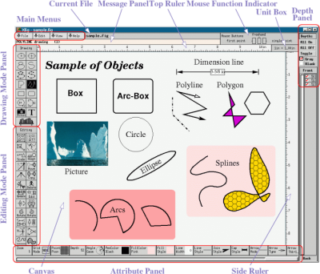
xfig

Slide 48
A Quicker Starting Point …
The Domain Model from Requirements Specification -- but very coarse/high-level
Refined/detailed … with more classes
Try the Hotel Management System … (key?, receptionist?, payment? …)

Slide 49
Roadmap
Preliminaries
Objects and Classes
What is Object-Oriented Design?
Finding Classes
Class Selection Rationale
CRC Cards
Identifying Responsibilities
Finding Collaborations

Slide 50
Class Responsibility Collaboration Cards
Use CRC cards to record candidate classes:
Record the candidate Class Name and superclass (not yet known)
Record each Responsibility and the Collaborating classes
compact, easy to manipulate, easy to modify or discard!
easy to arrange, reorganize
easy to retrieve discarded classes
Text Creation Tool subclass of Tool
Editing Text
Notes:
Need to explain in more detail what a CRC card is… and what it is good for!
Also worth noting that we should not prematurely identify class hierarchies!

Slide 51
CRC Cards (cont.)
CRC cards are not a specification of a design.
They are a tool to explore possible designs.
Prepare a CRC card for each candidate class
Get a team of Developers to sit around a table and distribute the cards to the team
The team walks through scenarios, playing the roles of instances of the identified (candidate) classes.
This exercise will uncover:
unneeded classes and responsibilities, and
missing classes and responsibilities.
Notes:
This is a VERY important aspect of RDD, in fact any kind of design! Hence I need to stress this fact!

Slide 52
Roadmap
Preliminaries
Objects and Classes
What is Object-Oriented Design?
Finding Classes
Class Selection Rationale
CRC Cards
Identifying Responsibilities
Finding Collaborations

Slide 53
Responsibilities
What are responsibilities?
the knowledge an object maintains and provides,
the actions it can perform.
Responsibilities represent the public services an object may provide to clients (but not the way in which those services may be implemented)
specify what an object does, not how it does it.
Do not describe the interface yet, only conceptual responsibilities.
Notes:
It may be worth re-iterating on the last dot point in more detail!!

Slide 54
Identifying Responsibilities
Study the requirements specification:
highlight verbs and determine which represent responsibilities
perform a walk-though of the system
explore as many scenarios as possible
identify actions resulting from input to the system
Study the candidate classes:
class names ⇒ roles ⇒ responsibilities
recorded purposes on class cards ⇒ responsibilities
Notes:
each class exists because of an implied responsibility

Slide 55
How to assign responsibility?
Pelrine’s Laws:
“Don't do anything you can push off to someone else.”
“Don't let anyone else play with you.”
Notes:
These are just two of common guidelines (“best practice”) one can apply…

Slide 56
Assigning Responsibilities
Evenly distribute system intelligence
avoid procedural centralization of responsibilities
keep responsibilities close to objects rather than their clients
Note: this is not always possible (or even desirable)!
State responsibilities as generally as possible
“draw yourself” vs. “draw a line/rectangle etc.”
leads to sharing
Keep behavior together with any related information
principle of encapsulation.
Notes:
I may comment a bit more on evenly distributing system intelligence here…

Slide 57
Assigning Responsibilities (cont.)
Keep information about one thing in one place
if multiple objects need access to the same information
a new object may be introduced to manage the information, or
one object may be an obvious candidate, or
the multiple objects may need to be collapsed into a single one
Share responsibilities among related objects
break down complex responsibilities
Maintaining information is a responsibility
But: avoid “data-holder” only classes!
E.g., Drawing Editor, Drawing, Drawing Element
Notes:
A Drawing Editor knows when the drawing has changed; the Drawing knows which elements to display; each Drawing Element knows how and where its presentation should be drawn ...

Slide 58
Relationships Between Classes
Additional responsibilities can be uncovered by examining relationships between classes, especially:
The “Is-Kind-Of” Relationship:
classes sharing a common attribute often share a common superclass
common super-classes suggest common responsibilities
To create a new Drawing Element, a Creation Tool must:
accept user input implemented in subclass
determine location to place it generic
instantiate the element implemented in subclass

Slide 59
Relationships Between Classes (cont.)
The “Is-Analogous-To” Relationship:
similarities between classes suggest as-yet-undiscovered superclasses
The “Is-Part-Of” Relationship:
distinguish (don’t share) responsibilities of part and of whole
Difficulties in assigning responsibilities suggest:
missing classes in design, or — e.g., Group Element,
free choice between multiple classes.

Slide 60
Example Relationships
Drawing element is-part-of Drawing
Drawing Element has-knowledge-of Control Points
Rectangle Tool is-kind-of Creation Tool

Slide 61
Roadmap
Preliminaries
Objects and Classes
What is Object-Oriented Design?
Finding Classes
Class Selection Rationale
CRC Cards
Identifying Responsibilities
Finding Collaborations

Slide 62
Collaborations
What are collaborations?
collaborations are client requests to servers needed to fulfill responsibilities,
collaborations reveal control and information flow
collaborations can uncover missing responsibilities,
analysis of communication patterns can reveal misassigned responsibilities.

Slide 63
Finding Collaborations
For each responsibility:
Can the class fulfill the responsibility by itself?
If not, what does it need, and from what other class can it obtain what it needs?
For each class:
What does this class know?
What other classes need its information or results? Check for collaborations.
Classes that do not interact with others should be discarded. (Check carefully!)

Slide 64
Listing Collaborations
Drawing
Knows which elements it contains
Maintains order of elements | Drawing Element

Slide 65
Summary
An application = a set of interacting objects
An object = an implementation of one or more roles
A role = a set of related responsibilities
A responsibility = an obligation to perform a task or know certain information
A collaboration = an interaction of objects or roles
Notes:
We will talk more about roles and responsibilities in the next lecture

Slide 66
Questions for Consideration
How do classes differ from objects?
Coupling and cohesion are two important concepts to consider when designing a software system. How can the requirements for each be achieved and what needs to be considered with the knowledge that the software will expand over time?
Given the fact that future releases may be ported to different platforms, how can the software be designed in a way that anticipates this change?
Why is it important to differentiate interfaces from implementation? What happens if this is not adhered to?
When assigning responsibilities for objects in OO design, why is it recommended to avoid 'data holder' only classes?

Slide 67
Question to Answer – week 5
In what way are objects, the artificial building blocks of a machine or software system, similar to a living, biological organism? What role do they play in helping us to understand and think about a problem?

Slide 68
Required Reading Lecture 6
Robert C. Martin, UML for Java Programmers, Prentice Hall, 2003, Chapter 11 (available from Canvas).
Bertrand Meyer, Applying “Design by Contract”, IEEE Computer, October 1992, (available from Canvas).

